Slide 1
Organizational Consulting
Stakeholder-Driven
Strategic Planning
Supporting, Promoting, and Advancing Public Education

Slide 2
Stakeholder-Driven Strategic Planning:
Plan Review
Al Brown, Organizational Services
Email: abrown@wasb.org
Phone: 715-577-0913

Slide 3
Meeting Goals
Presentation and review of the draft strategic plan
Recommendation for minor changes and updates
Steering Committee approval and recommendation to the Board of Education

Slide 4
Final Draft

Slide 5
Presentation of the Plan Strategies and Outcomes
Changes from the previous draft
Review of the strategies when compared to the committee and community documentation
Review strategic plan document (handout)

Slide 6
Discussion of the Draft Strategies

Slide 7
Possible Changes or Modifications
Discussion of the Strategic Themes or Goals
Controversial notes or issues
Review of the strategies and/or outcomes
Are there items that warrant a closer look or a strategic objective?
In which strategy does it belong?
Area for potential revision
What are the criteria for revision?
Why is this important?
What is the educational or community impact of this revision?
Where is the support for this revision in the data?

Slide 8
Board Meeting

Slide 9
Board of Education Meeting
Final strategic plan
Plan to be assembled from the findings of Steering Committee’s work
Highlight current initiatives
Monitoring cycle (e.g. Plan-Do-Study-Act deployment strategy)
Board member roles
Committee structure
Charges to the committee (recommend formal documentation)
Discussion of process as it relates to board work
Date of board meeting
Finalize the plan for board approval

Slide 10
Annual Plan Update (Stakeholder Driven Strategic Planning Steering Committee)
Celebrate your successes
Communicate
Linkage with the communities (internal and
external)
Review the monitoring reports from the previous planning cycle
Review Master Stakeholder Driven Strategic Plan
Identify plan components to carry forward (if
any)
Identify new plan components for the next
cycle

Slide 11
Consultant Recommendations
Laser-like focus on student learning.
Multiple levels of support for social-emotional well-being of students.
Sustained community involvement initiatives.
Developing a data collection and reporting system.
Creating periodic board development sessions.
Monitor progress at regular board meetings.

Slide 12
THANK YOU

Slide 13
Presentation of the Stakeholder-Driven Strategic Plan
The Results of Your Hard Work

Slide 14
Board of Education
Implementation Resources and Tools
(These sides are additional information that cam be shared with the School Board now or in the future)

Slide 15
Implementation
Process management
Individuals, departments or committees
Participants
Communication
Move beyond the board and admin.
Accountability
Measures or success
Frequency
Monitoring and reporting

Slide 16
Process MANAGEMENT
Who is directly responsible for management:
Superintendent
Scope and scale of the process
Work is carried out by individuals or groups (old and new)
Connection between the policy and means
Clarity of roles
Explicit outcomes, monitoring, and timelines (documentation)
Notes:
Assumptions
What gets measured gets done

Slide 17
Communication
Communicate with the community outside of the board meeting
Linkage with the community
Progress towards outcomes or goals
Move beyond comfort zone of most board members
Communication Plan
Develop “district message” based on vision
Key communicators
Internal and external
Notes:
Understandable and reasonable (plan on a page)
Discuss linkages with the community… focal point can be the vision and strategic planning for the school district

Slide 18
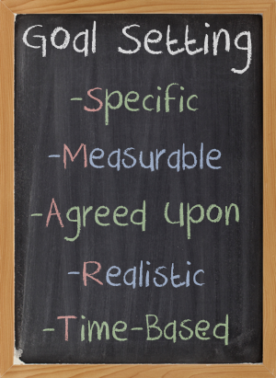
Accountability
Measures of the outcomes
SMART goals
Measure the results not process
Reporting
Consistent monitoring by the
school board
Scheduled and formal
Documentation
“Making reasonable progress”
Board action
Notes:
Continuous and constant process – becomes a way of life
Modeling strong leadership practices
“What gets measured gets done”

Slide 19
Frequency: Monitoring progress
Board Agenda Planning
Yearly plan
Timeline is a helpful to communicate expectations and results
90 day cycle in a good place to start
Balance the work load
School board
Staff
Notes:
Agenda planning is a key school board tool
Meaningful board actions

Slide 20
Goal Areas – Sample
Academic Knowledge and Skills
We will graduate students having attained individually challenging levels of
academic performance with the ability to apply their knowledge and skills.
Tactic 1: The Common Core State Standards will be integrated within all Learning Targets. These Learning targets will be published for all grade levels and classes. 2013-14
Tactic 2: Educator Effectiveness initiative will be piloted and deployed in the 2014-15 school year.
Tactic 3: New student assessments (e.g. Smarter Balanced Assessment, PALS, EPAS) will be deployed to measure student performance.
Tactic 4: Teaching strategies will be modified based on measures of student performance to improve learning.
Tactic 5: Gaps in student performance will be reduced by 10- percent each year.
Notes:
MANAGING A STRATEGIC PROCESS
The District now has a strategic plan: so now what? The Board of Education, senior administrators, staff members and community members have developed a strategic plan document with strategies and tactics. This is the first phase of operating strategically.
The next phase is to convert the “Plan” into action. This is done by developing specific action plans for each strategy or tactic

Slide 21
Monitoring Schedule - Sample
Mission = District Mission and Vision; AK&S = Academic Knowledge and Skills; H&S = Health and Safety; C&C = College and Career; CO of our S = Community Ownership of Our Schools

Slide 22
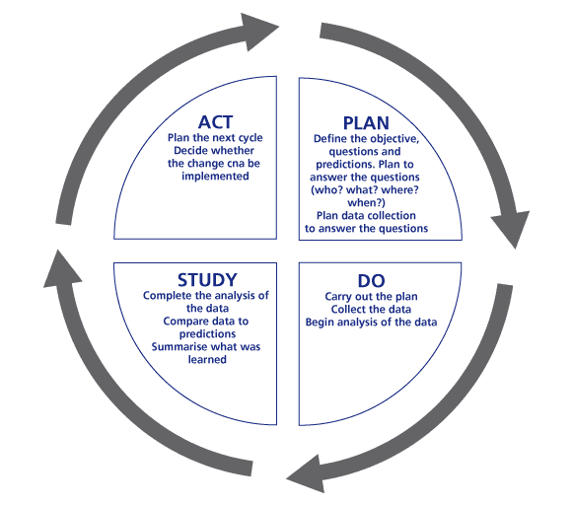
Tools
PDSA
or the Deming Cycle
Notes:
Start simple and increase the complexity as the system matures

